Slide 1
بسم الله الرحمن الرحیم
Notes:
Introduce yourself
ان شاء الله که وخت خوب و پربرکت خواهیم داشت

Slide 2
JS101 Introduction to Web Programming with Javascript

Slide 3
Welcome
Notes:
Introduce yourself
ان شاء الله که وخت خوب و پربرکت خواهیم داشت

Slide 4
Agenda
Introduction
Course Structure
Algorithms
JavaScript

Slide 5
Introduction
Notes:
Name, education, experience
Ask student to introduce themselves? How many of them have prior programming experience? School or university?

Slide 6
Why JavaScript?

Slide 7





Slide 8










Slide 9
What ultimately matters is how to solve problems, and how to learn new languages and tools.

Slide 10
Course Structure
Notes:
teaching: only tells you how to do something
Training: correct your mistakes and guides you through each step.

Slide 11
Outline
Week1: function, variables,
Week 2: Objects
Week3: Runtime
Week4: DOM and Events
Week5: AJAX
Week6:SPA
Week7: ReactJS Intro
Week8: Thinking in React

Slide 12
Teaching vs Training
Notes:
teaching: only tells you how to do something
Training: correct your mistakes and guides you through each step.

Slide 13
عالم بی عمل – درخت بی ثمر
Notes:
Our teaching philosophy: learn by doing.
چطور در یک شهر نو بلد میشوید.
اول چیز های را یاد بگیر که زیاد سروکار داشته باشی همرایش.
Course suggestion: learning how to learn on Coursera.

Slide 14
what ultimately matters in this course is not so much where you end up relative to your classmates but where
you end up relative to yourself when you began
Notes:
experience that matters is yours
not a competition

Slide 15
Computer Science
Notes:
Introduce yourself
ان شاء الله که وخت خوب و پربرکت خواهیم داشت

Slide 16
input →
Process
→ output
Notes:
Representations: counting on hand, counting with decimal, but computers only have 0s and 1s
Basically computer does 5 basic operations that are input, output, process, storing and controlling.

Slide 17
🖐️

Slide 18
123

Slide 19
1
123

Slide 20
10
1
123

Slide 21
100
10
1
123

Slide 22
100
10
1
123
100 × 1

Slide 23
100
10
1
123
100 × 1
+
10 × 2

Slide 24
100
10
1
123
100 × 1
+
10 × 2
+
1 × 3

Slide 25
100
10
1
123
100
+
20
+
3

Slide 26
123

Slide 27
100
10
1
# # #
Notes:
But why 1, 10, and 100?

Slide 28
10²
10¹
10⁰
# # #

Slide 29
2²
2¹
2⁰
# # #

Slide 30
4
2
1
# # #

Slide 31
4
2
1
000

Slide 32
4
2
1
001

Slide 33
4
2
1
010

Slide 34
4
2
1
011

Slide 35
4
2
1
100

Slide 36
4
2
1
101

Slide 37
4
2
1
110

Slide 38
4
2
1
111

Slide 39
A

Slide 40
65

Slide 41
01000001

Slide 42
ASCII

Slide 43
... | A | B | C | D | E | F | G | H | I | ...
... | 65 | 66 | 67 | 68 | 69 | 70 | 71 | 72 | 73 | ...

Slide 44
72 | 73 | 33

Slide 45
H | I
72 | 73 | 33
Notes:
Call-on

Slide 46
H | I | !
72 | 73 | 33

Slide 47
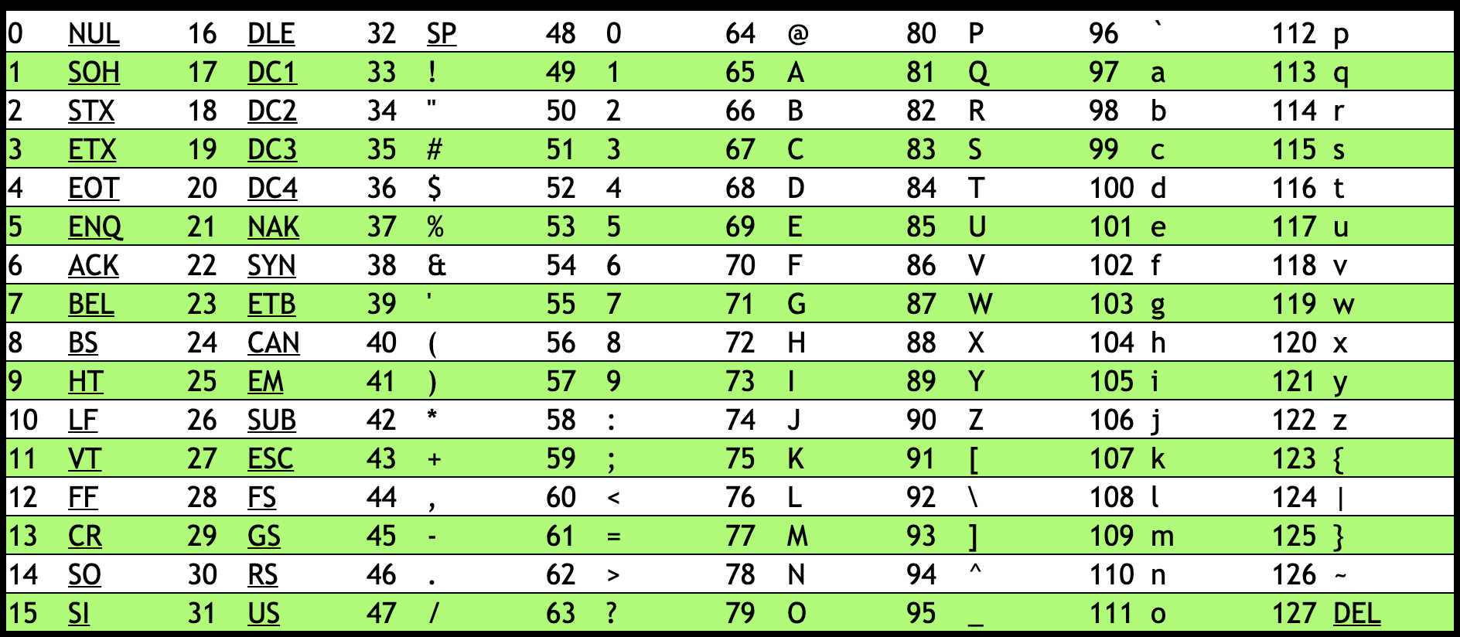
Notes:
https://asciichart.com/

Slide 48
H | I | !
72 | 73 | 33

Slide 49
H | I | !
01001000 | 01001001 | 00100001
Notes:
bytes

Slide 50
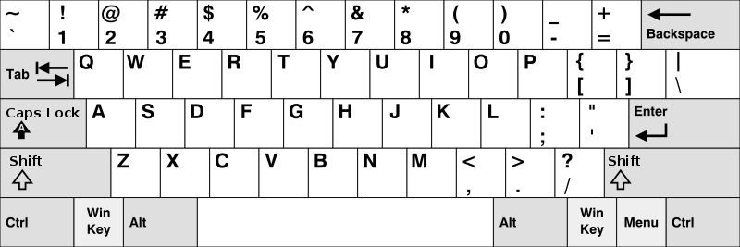
Notes:
https://en.wikipedia.org/wiki/British_and_American_keyboards
But how to represent other symbols?

Slide 51
Unicode

Slide 52
4,036,991,159

Slide 53
11110000 10011111 10011000 10110111

Slide 54

Notes:
https://emojipedia.org/face-with-medical-mask/
Google

Slide 55

Notes:
https://emojipedia.org/face-with-medical-mask/
Apple

Slide 56
Notes:
Should be #484921ff, but brightened for projectors.

Slide 57
RGB

Slide 59
72 | 73 | 33

Slide 60
72 | 73 | 33

Slide 62
Notes:
Should be #484921ff, but brightened for projectors.

Slide 63


Slide 64


Slide 65


Slide 66
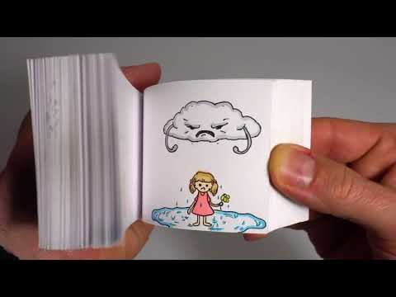
Notes:
https://youtu.be/p3q9MM__h-M

Slide 67
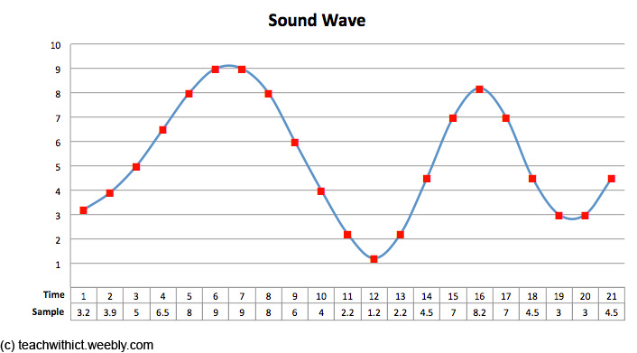
Notes:
note, duration, volume

Slide 68
input →
→ output

Slide 69
algorithm

Slide 70
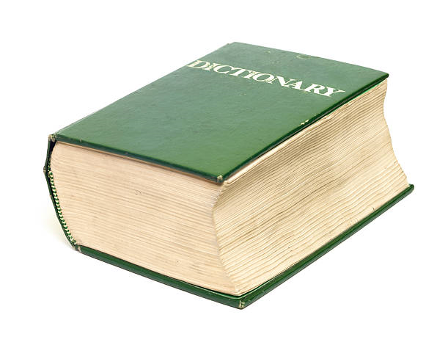
Notes:
https://apps.apple.com/us/app/contacts/id1069512615#?platform=iphone

Slide 71
pseudocode

Slide 72
1 Pick up dictionary
2 Open to middle of dictionary
3 Look at page
4 If word is on page
5 Read the Definition
6 Else if word is earlier in dictionary
7 Open to middle of left half of dictionary
8 Go back to line 3
9 Else if word is later in dictionary
10 Open to middle of right half of dictionary
11 Go back to line 3
12 Else
13 Quit

Slide 73
1 Pick up dictionary
2 Open to middle of dictionary
3 Look at page
4 If word is on page
5 Read the Definition
6 Else if word is earlier in dictionary
7 Open to middle of left half of dictionary
8 Go back to line 3
9 Else if word is later in dictionary
10 Open to middle of right half of dictionary
11 Go back to line 3
12 Else
13 Quit

Slide 74
1 Pick up dictionary
2 Open to middle of dictionary
3 Look at page
4 If word is on page
5 Read the Definition
6 Else if word is earlier in dictionary
7 Open to middle of left half of dictionary
8 Go back to line 3
9 Else if word is later in dictionary
10 Open to middle of right half of dictionary
11 Go back to line 3
12 Else
13 Quit

Slide 75
1 Pick up dictionary
2 Open to middle of dictionary
3 Look at page
4 If word is on page
5 Read the Definition
6 Else if word is earlier in dictionary
7 Open to middle of left half of dictionary
8 Go back to line 3
9 Else if word is later in dictionary
10 Open to middle of right half of dictionary
11 Go back to line 3
12 Else
13 Quit

Slide 76
1 Pick up dictionary
2 Open to middle of dictionary
3 Look at page
4 If word is on page
5 Read the Definition
6 Else if word is earlier in dictionary
7 Open to middle of left half of dictionary
8 Go back to line 3
9 Else if word is later in dictionary
10 Open to middle of right half of dictionary
11 Go back to line 3
12 Else
13 Quit

Slide 77
1 Pick up dictionary
2 Open to middle of dictionary
3 Look at page
4 If word is on page
5 Read the Definition
6 Else if word is earlier in dictionary
7 Open to middle of left half of dictionary
8 Go back to line 3
9 Else if word is later in dictionary
10 Open to middle of right half of dictionary
11 Go back to line 3
12 Else
13 Quit

Slide 78
functions
arguments, return values
conditionals
Boolean expressions
loops
variables
...

Slide 79
Let dictionary;

Slide 80
function pickup()
{
}

Slide 81
if()
{
}
else
{
}

Slide 82
While()
{
}

